Slide 1
Heterogeneous FPLDs

Slide 2
Heterogeneous Logic Blocks
Mixture of two different sizes of LUTs:
Larger LUT and cluster sizes: higher speed
Smaller sizes: more area efficient
Up to the CAD tool to select the resource
Mixture of PAL-like LBs and LUT-based LBs:
PAL blocks: improved circuit speed
LUT blocks: area and power efficiency
Mixture of “specific-purpose logic” and general-purpose LBs:
SP LBs: superior area, speed, and power consumption
If the function is not used, the silicon area is wasted

Slide 3
Heterogeneous Logic Blocks
Key questions:
Which kinds of SP functions?
What should be the ratio: SP/GP?
What can be done about SP LBs not used in a specific application?
Rose’s golden rule: “build structures that are always useful, even if that use is less than perfectly efficient.”
“The more useful a hard structure is, across a wider range of applications, then the greater its net benefit - provided the cost of the extra functionality is not excessive.”
Rose. Hard vs. Soft: The Central Question of Pre-Fabricated Silicon. In Proceedings of the 34th International Symposium on Multiple-Valued Logic (ISMVL’04), 2004.

Slide 4
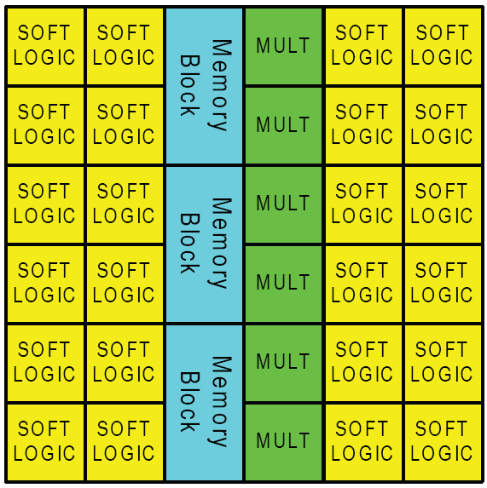
Hard Blocks
Common hard blocks in modern FPGAs:
Memory
Multipliers
MAC for DSP applications
Microprocessors
…

Slide 5
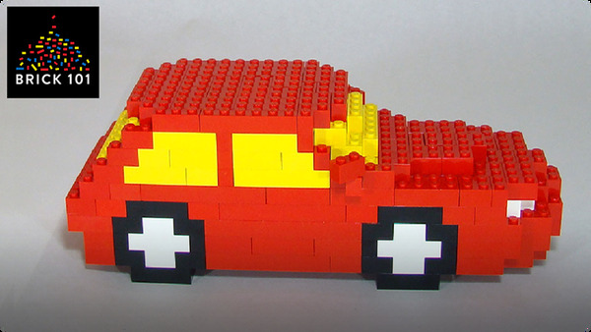

Hard Blocks
Logic Blocks vs. SP Blocks

Slide 6

Hard Blocks
Logic Blocks vs. SP Blocks

Slide 7
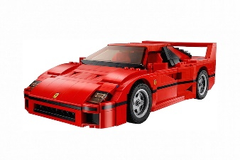
Hard Blocks
Logic Blocks vs. SP Blocks

Slide 8


Hard Blocks
Logic Blocks vs. SP Blocks

Slide 9
Embedded Memories

Slide 10
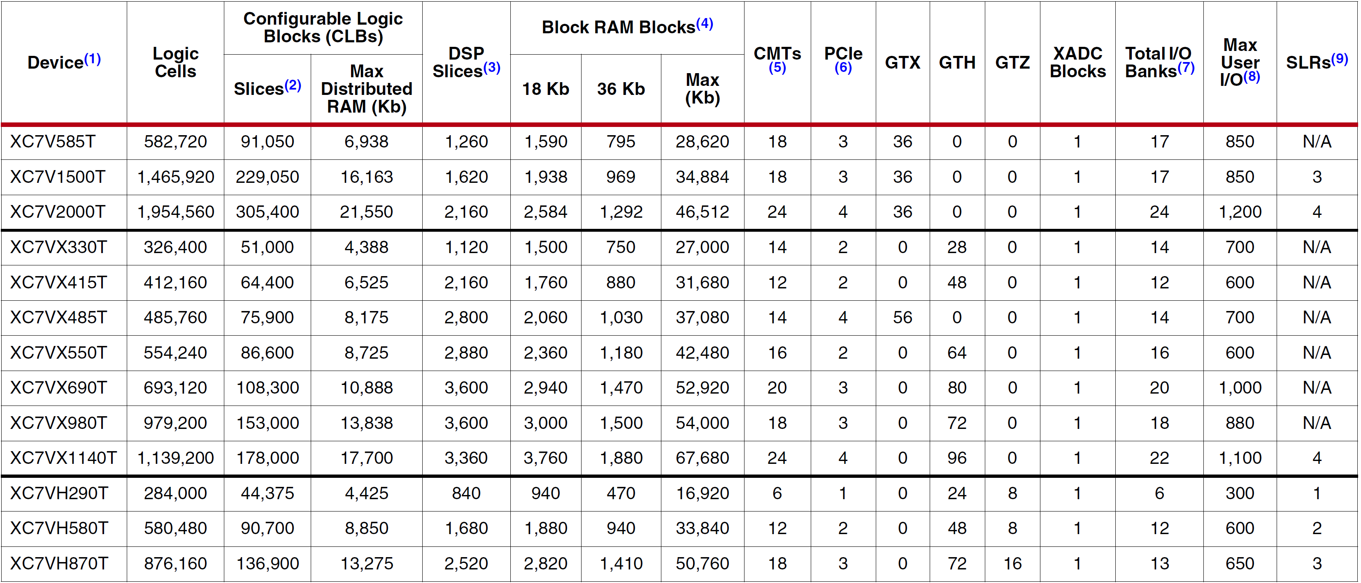
Virtex 7
Block RAMs are fundamentally 36 Kb in size; each block can also be used as two independent 18 Kb blocks.

Slide 11
Xilinx FPGAs
 | Spartan-6 | Artix-7 | Kintex-7 | Virtex-7 | Kintex UltraScale | Virtex UltraScale
Logic Cells | 147,443 | 215,360 | 477, 760 | 1,954,560 | 1,160,880 | 4,407,480
BlockRAM | 4.8Mb | 13Mb | 34Mb | 68Mb | 76Mb | 115Mb
DSP Slices | 180 | 740 | 1,920 | 3,600 | 5,520 | 2,880
Transceiver Count | 8 | 16 | 32 | 96 | 64 | 104
Transceiver Speed | 3.2 Gb/s | 6.6 Gb/s | 12.5 Gb/s | 28.05 Gb/s | 16.3 Gb/s | 32.75 Gb/s
Total Transceiver Bandwidth (full duplex) | 50 Gb/s | 211 Gb/s | 800 Gb/us | 2,784 Gb/s | 2,086 Gb/s | 5,101 Gb/s
I/O Pins | 576 | 500 | 500 | 1,200 | 832 | 1,456

Slide 12
Heterogeneous Logic Blocks
Each M10K (M20K) block in Intel Cyclone:
10Kb bits if used as memory
Dual port RAM, ROM, FIFO, …
Can be used as logic

Slide 13
Cyclone M10K Blocks
M10K (Bits)
256 × 40 or 32
512 × 20 or 16
1K × 10 or 8
2K × 5 or 4
4K × 2
8K × 1
In single- or dual-port mode

Slide 14
Configuration as Memory
A[7..0]
D[31..0]
A[8..0]
D[15..0]
A[9..0]
D[7..0]
256x32
A[12..0]
D0
512x16
1028x8
8kx1

Slide 15
Configuration as Memory
Can be used independently
Can be combined for a larger memory
A[9..0]
D[7..0]
1024x8
D[15..0]
A[9..0]
A[9..0]
D[7..0]
1024x 8

Slide 16
Intel Cyclone
Notes:
Cyclone III devices feature OCT to provide I/O impedance matching and termination capabilities.
OCT helps to prevent reflections and maintain signal integrity while minimizing the need for
external resistors in high pin-count ball grid array (BGA) packages.

Slide 17
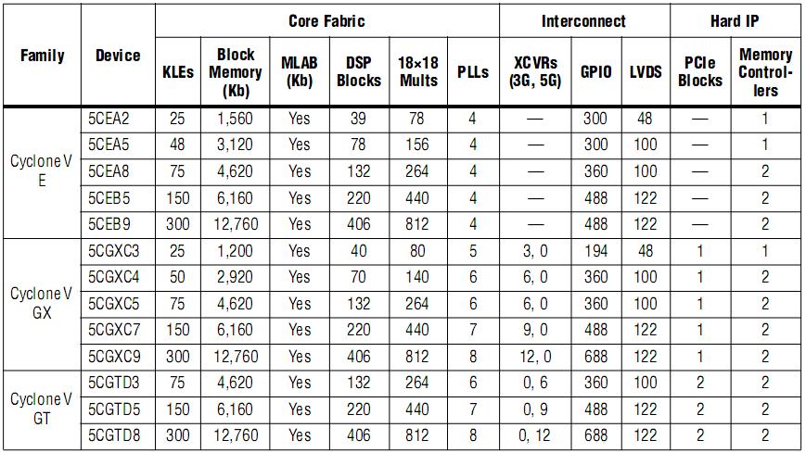
Cyclone V

Slide 18
Memory Modes
Simple dual-port mode:
Supports simultaneous read and write operation to different locations.
True dual-port mode:
Supports any combination of two-port operations:
two reads,
two writes,
one read and one write,
at two different clock frequencies.

Slide 19
Altera Stratix II Embedded Memory

Slide 20
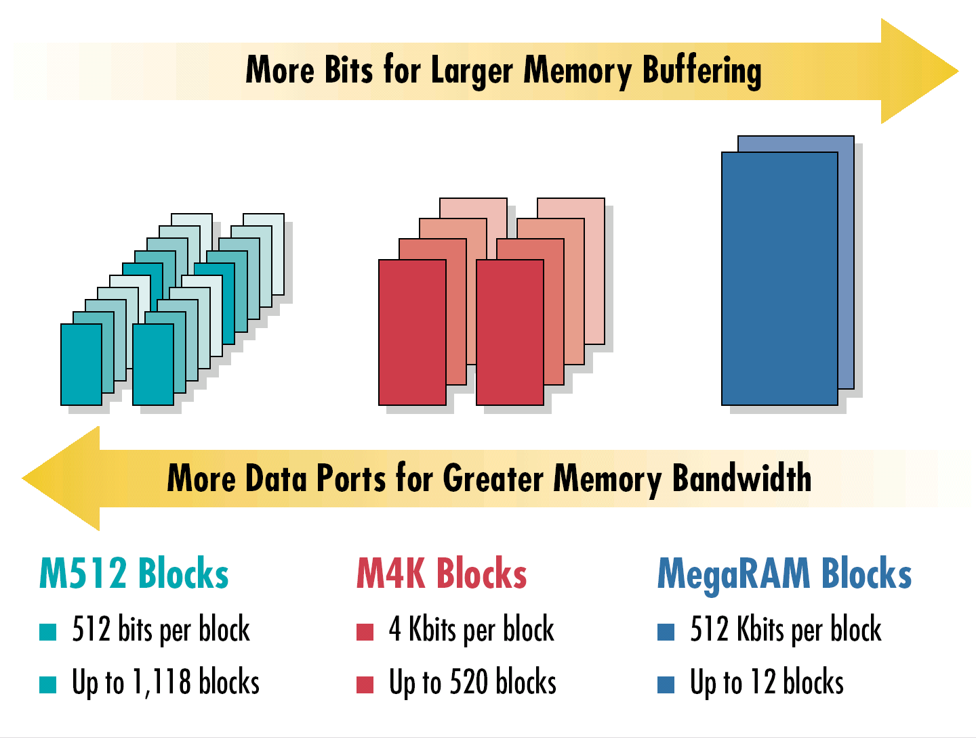
TriMatrix Memory Structure

Slide 21
حافظه در Cyclone
دو نوع:
بلوک‌های M10K:
8 کیلوبیت:
هر 4 بیت: 1 بیت توازن (parity)
10 کیلوبیت داده
Single/dual port
(در Cyclone IV:
بلوک‌های M9K
بلوک‌های M144K)
MLAB:
640-bit dual port RAM
هر ALM: 32 x 2
برای shift register و FIFO کوچک
پیکربندی ( تعداد بیت × تعداد کلمات )
40 × 256
32 × 256
20 × 512
16 × 512
10 × k 1
8 × k 1
5 × k 2
4 × k 2
2 × k 4
1 × k 8

Slide 22
بلوک‌های منطقی و معماری اتصالات

Slide 23
حافظه بلوکی در تراشه های UltraScale+ شرکت Xilinx
بلوک‌های UltraRAM:
288 کیلوبیت:
4096 × 72 بیت
تراشه ها:
Kintex UltraScale+ (تا 22/5 مگابیت)
Zynq UltraScale+ (تا 22/5 مگابیت)
Virtex UltraScale+ (تا 360 مگابیت)

Slide 24
تکلیف

Slide 25
Configuration as Logic Function
Remember:
What can be done about SP LBs not used in a specific application?
Can be used as a big LUT
E.g. Square root: 8-input, 8-output memory module
Advantages (vs. small LUT implementation):
Higher speed
Predictable speed
Can implement either independently or combined to implement larger functions

Slide 26
Applications of Embedded Memory
داده | آدرس
0 | 0
1 | 1
1/4 | 2
1/7 | 3
2 | 4
2/2 | 5
... | ...
√n | N

Slide 27
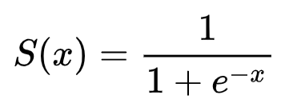
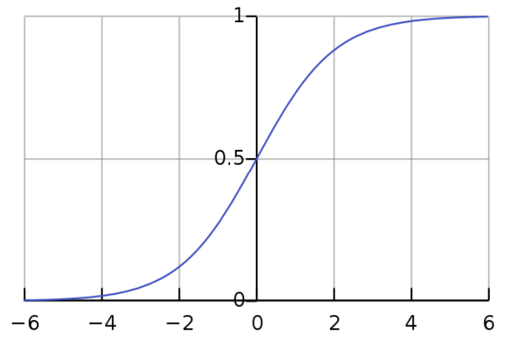
Applications of Embedded Memory
تابع سیگموید

Slide 28
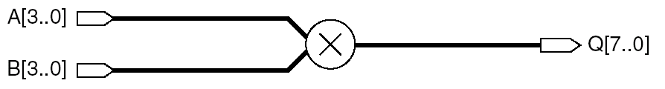
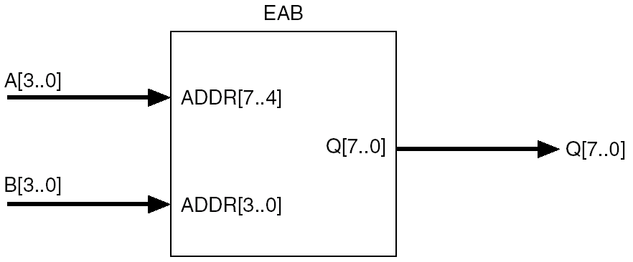
Applications of Embedded Memory
4x4 Multiplier
or any complex math function

Slide 29
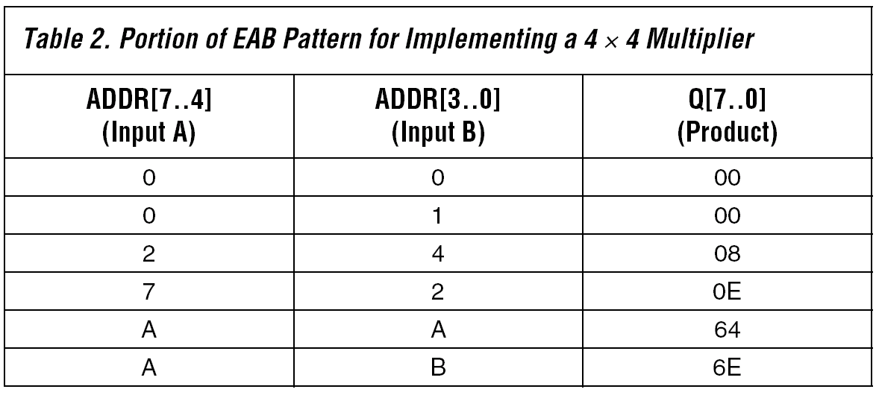
Applications of Embedded Memory
4x4 Multiplier
or any complex math function
For larger multipliers, can use several 4x4 mults + adders

Slide 30
Applications of Embedded Memory
داده | آدرس
0 | 0
1 | 1
1/4 | 2
1/7 | 3
2 | 4
2/2 | 5
... | ...
√n | N
دقت محاسبه:
جذر اعدادی که در جدول نیستند (1/5):
گرد کردن
کوتاه کردن
تقریب خطی
دقیق‌تر
سخت‌افزار اضافی

Slide 31
Applications of Embedded Memory
Constant multiplication
For DSP and control systems
Constant value determines memory content patterns
If constant is changed, can load new values
Multiplication precision can be set (cost saving)

Slide 32
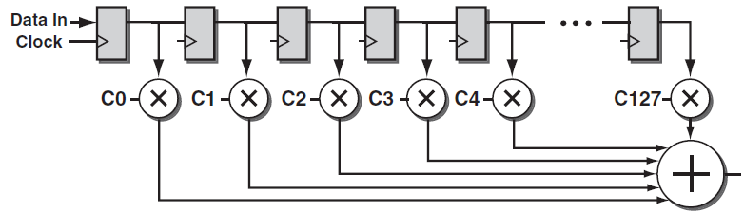
FIR (Finite Impulse Response) Filter

Slide 33
Applications of Embedded Memory
Transcendental functions
sin, cos, …, logarithm, …
Costly/complex hardware implementation
Arguments: α → address lines
Results: sin(α) → data lines

Slide 34
پیاده­سازی ماشین حالت با حافظه
ماشین فروش شکلات:
حالت جاری |  |  | ورودی ها |  | حالت بعدی |  | خروجی
 | S1 | S0 | D | P | S1 | S0 | DOOR
(start) | 0 | 0 | 0 | 0 | 0 | 0 | 0
 |  |  | 0 | 1 | 1 | 1 | 0
 |  |  | 1 | 0 | 0 | 1 | 0
 |  |  | 1 | 1 | X | X | X
(P200) | 0 | 1 | 0 | 0 | 0 | 1 | 0
 |  |  | 0 | 1 | 1 | 1 | 0
 |  |  | 1 | 0 | 1 | 0 | 0
 |  |  | 1 | 1 | X | X | X
(P400) | 1 | 0 | 0 | 0 | 1 | 0 | 0
 |  |  | 0 | 1 | 1 | 1 | 0
 |  |  | 1 | 0 | 1 | 1 | 0
 |  |  | 1 | 1 | X | X | X
(full) | 1 | 1 | 0 | 0 | 1 | 1 | 1
 |  |  | 0 | 1 | 1 | 1 | 1
 |  |  | 1 | 1 | 1 | 1 | 1
 |  |  | 1 | 0 | 1 | 1 | 1

Slide 35
پیاده­سازی ماشین حالت با حافظه
ماشین فروش شکلات:
حالت جاری |  |  | ورودی ها |  | حالت بعدی |  | خروجی
 | S1 | S0 | D | P | S1 | S0 | DOOR
(start) | 0 | 0 | 0 | 0 | 0 | 0 | 0
 |  |  | 0 | 1 | 1 | 1 | 0
 |  |  | 1 | 0 | 0 | 1 | 0
 |  |  | 1 | 1 | X | X | X
(P200) | 0 | 1 | 0 | 0 | 0 | 1 | 0
 |  |  | 0 | 1 | 1 | 1 | 0
 |  |  | 1 | 0 | 1 | 0 | 0
 |  |  | 1 | 1 | X | X | X
(P400) | 1 | 0 | 0 | 0 | 1 | 0 | 0
 |  |  | 0 | 1 | 1 | 1 | 0
 |  |  | 1 | 0 | 1 | 1 | 0
 |  |  | 1 | 1 | X | X | X
(full) | 1 | 1 | 0 | 0 | 1 | 1 | 1
 |  |  | 0 | 1 | 1 | 1 | 1
 |  |  | 1 | 1 | 1 | 1 | 1
 |  |  | 1 | 0 | 1 | 1 | 1
آدرس | محتوای حافظه
0000 | 0 | 0 | 0
0001 | 1 | 1 | 0
0010 | 0 | 1 | 0
0011 | 0 | 0 | 0
0100 | 0 | 1 | 0
0101 | 1 | 1 | 0
0110 | 1 | 0 | 0
0111 | 0 | 0 | 0
1000 | 1 | 0 | 0
1001 | 1 | 1 | 0
1010 | 1 | 1 | 0
1011 | 0 | 0 | 0
1100 | 1 | 1 | 1
1101 | 1 | 1 | 1
1110 | 1 | 1 | 1
1111 | 1 | 1 | 1

Slide 36
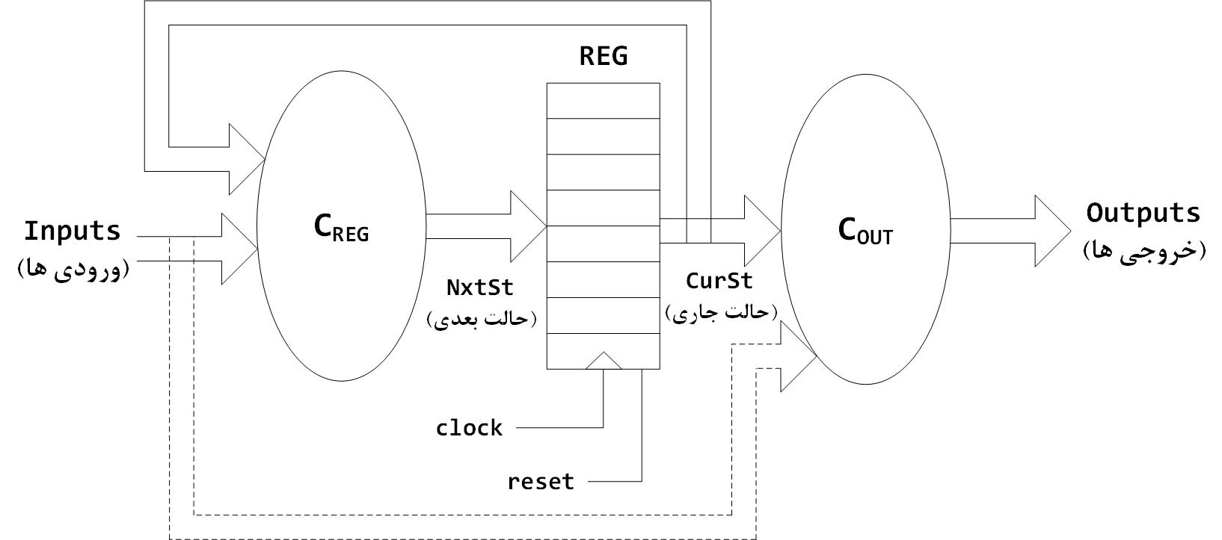
پیاده­سازی ماشین حالت با حافظه
حافظه باید همگام با کلاک باشد

Slide 37
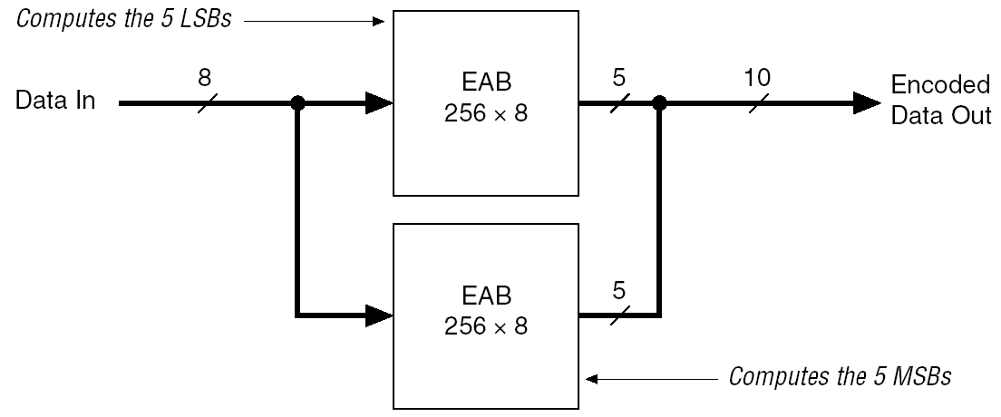
Applications of Embedded Memory
Code converters

Slide 38
Computation-Oriented Tiles

Slide 39
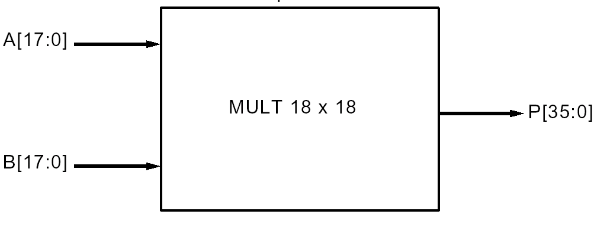
18x18 Multipliers
For computational applications and DSP

Slide 40
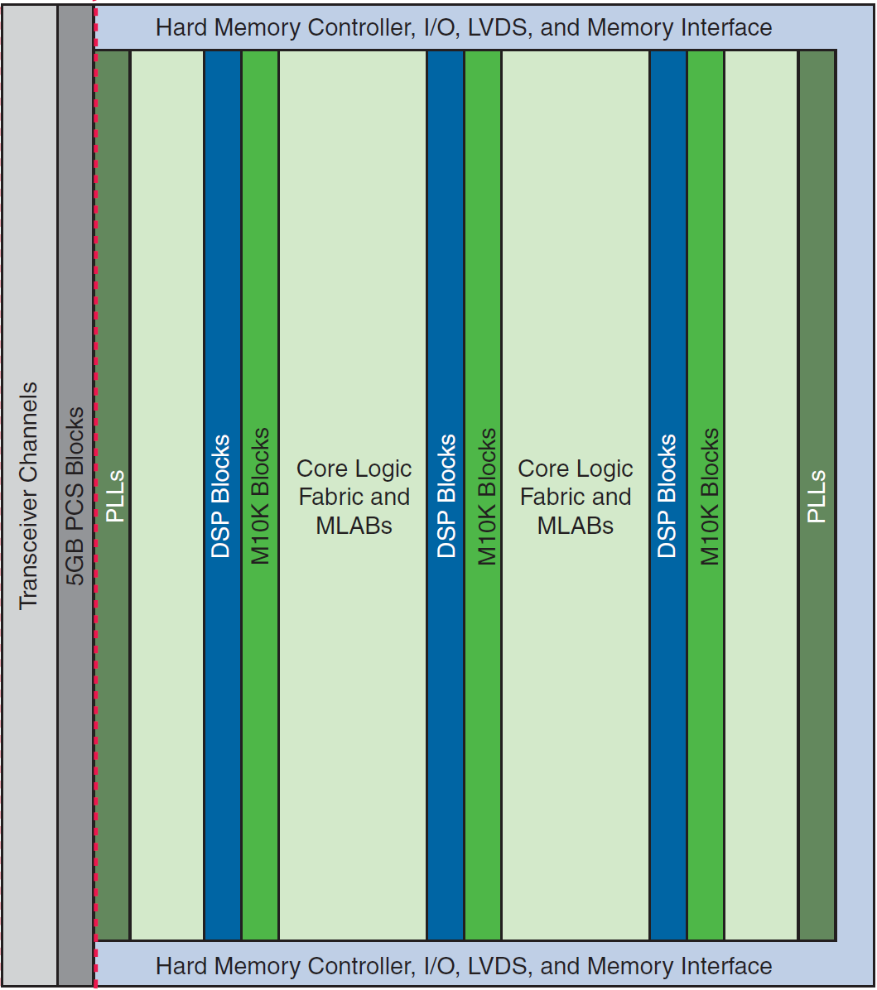
Multipliers in Altera Cyclone V
Multipliers in DSP blocks

Slide 41
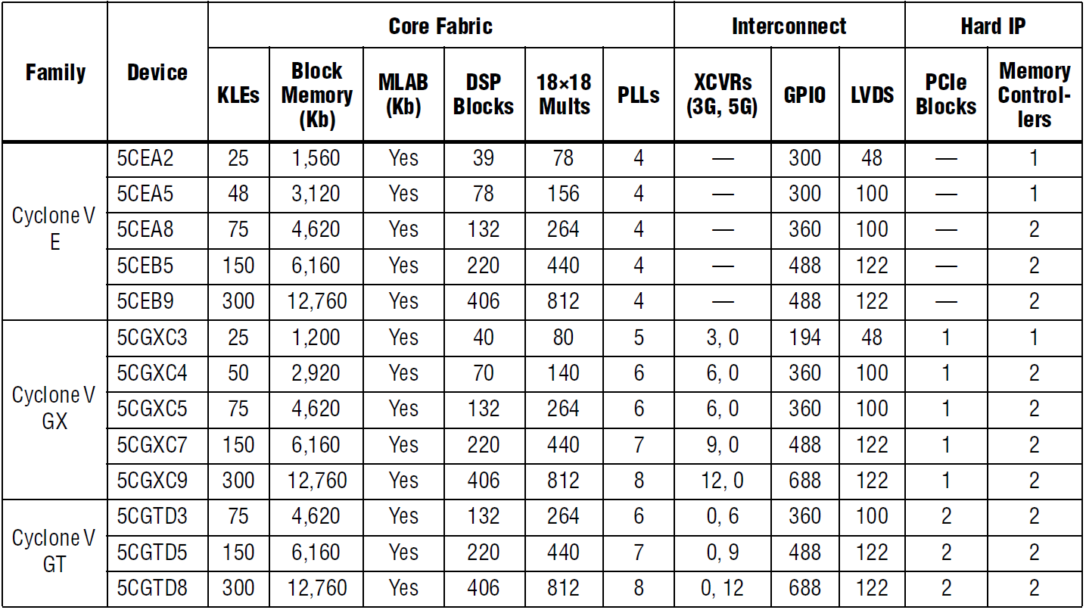
Embedded Multipliers in Cyclone V
Cyclone 10:
Up to 200 DSP blocks but with 54 x 54 bit floating point multipliers

Slide 42
Embedded Multipliers
Variable Precision DSP Blocks:
Can configure each embedded multiplier as
one 27 × 27 or
two 18 × 18 or
three 9 × 9.
For > 27 × 27, the Quartus Prime software cascades.
No restriction on the data width
but the greater the data width, the slower the multiplication process.
Can also implement soft multipliers using memory blocks.
→ Increase the number of multipliers.
Other features of DSP blocks:
18 × 18 bit internal coefficient register banks
Adder
64-bit accumulator

Slide 43
Multiplier Block Architecture

Slide 44
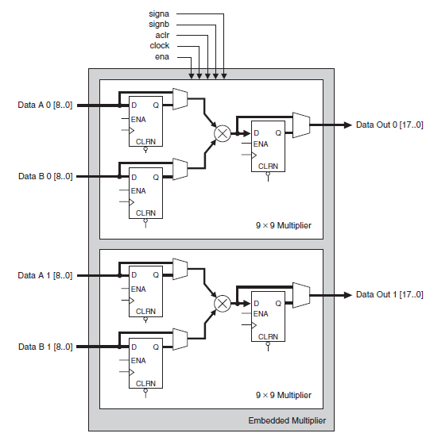
9-Bit Mode

Slide 45
DSP Blocks

Slide 46
Stratix DSP Blocks

Slide 47
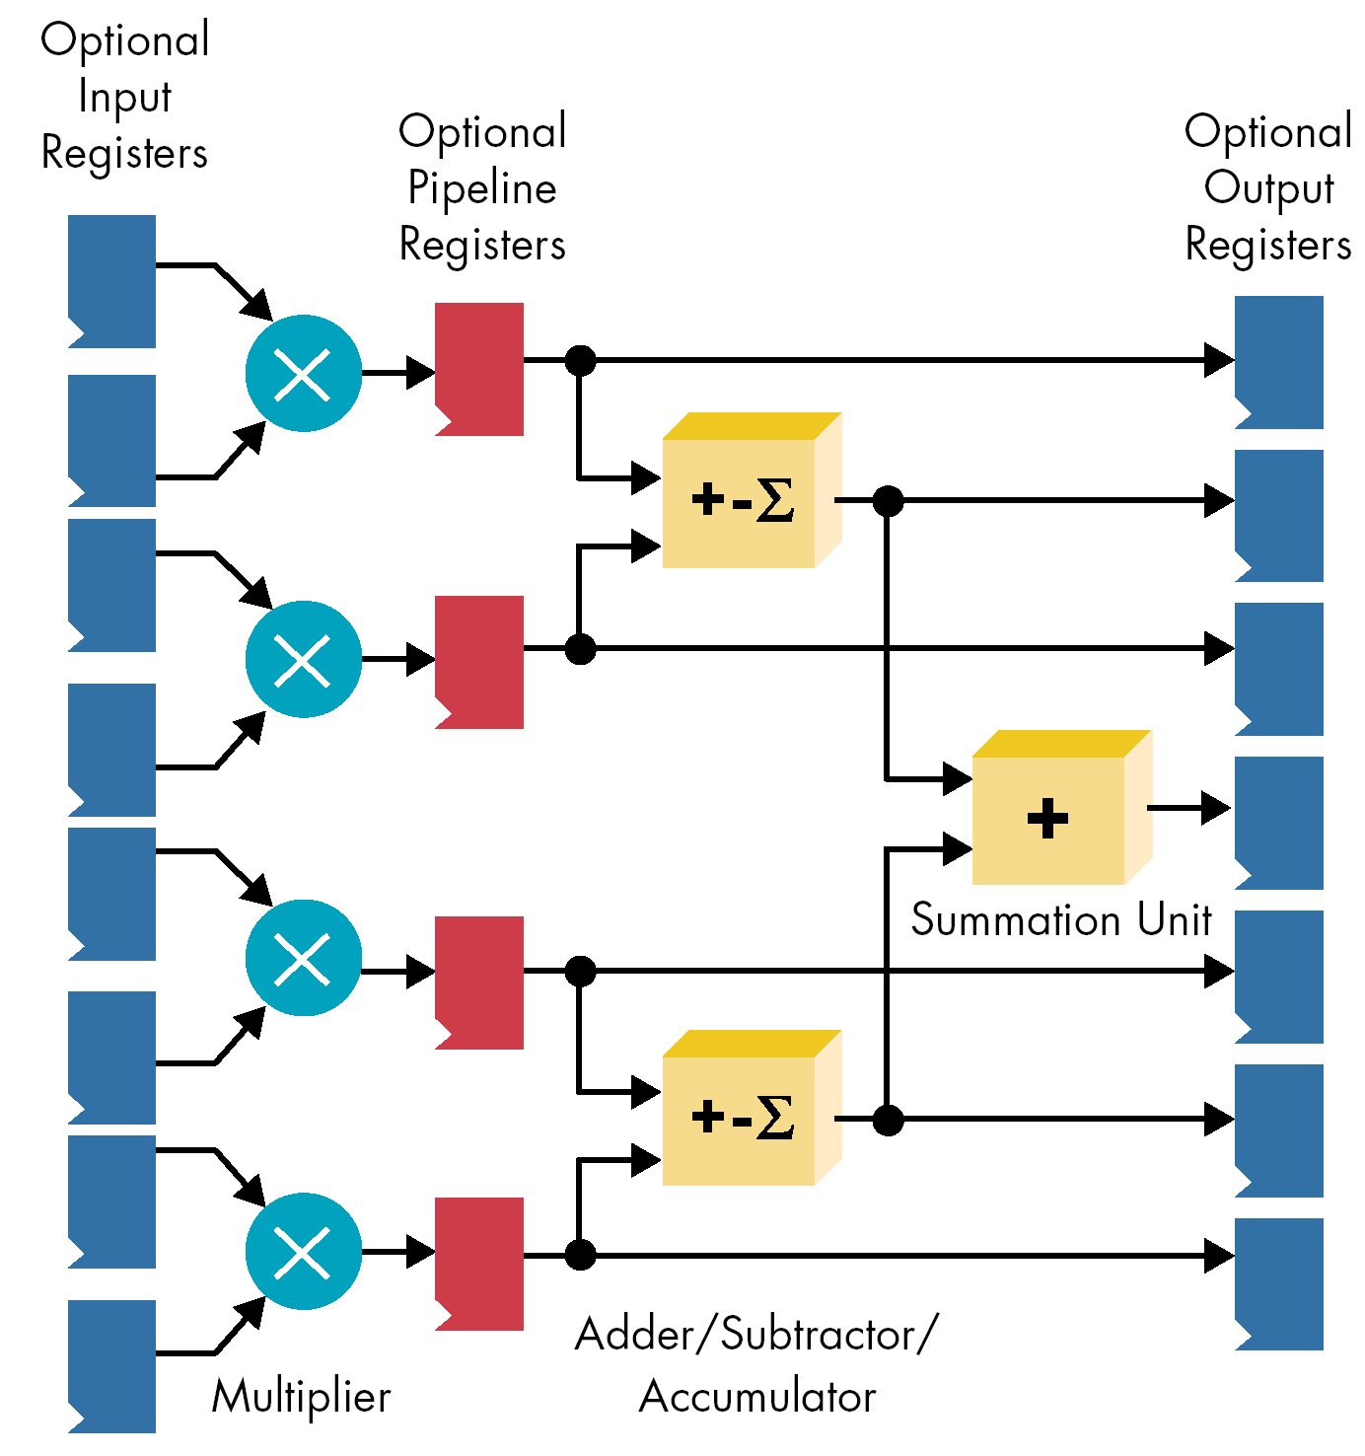
Stratix II DSP Blocks

Slide 48
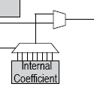
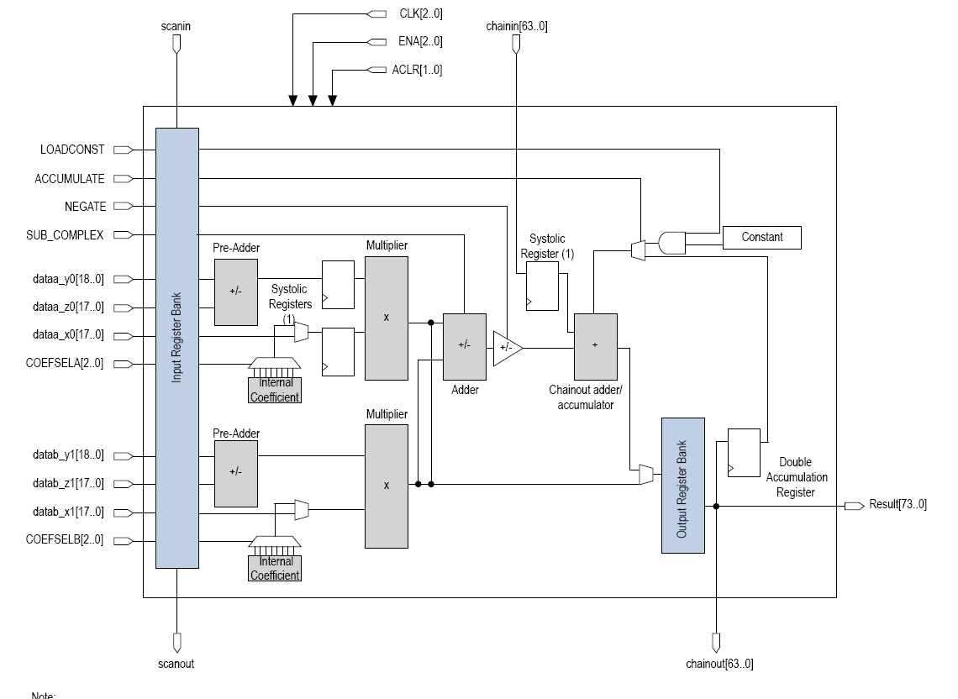

Slide 49
Ratio-Based Architectures
If multipliers not needed by an application, the multipliers provide little benefit.
Solution: multiple sub-families within a device family with different ratios of soft logic to hard-logic.
Designer can select the device with the most appropriate ratio
→ Minimize “wasted” area
→ FPGA vendor must support a larger number of devices
soft/hard ratio
462
190
272

Slide 50
Embedded Processors

Slide 51
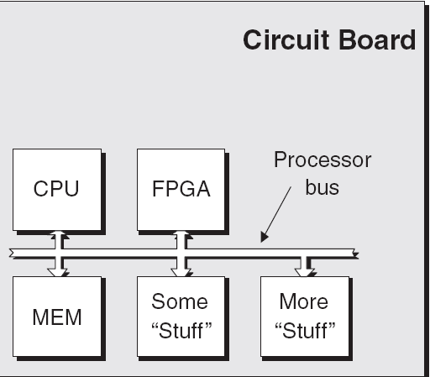
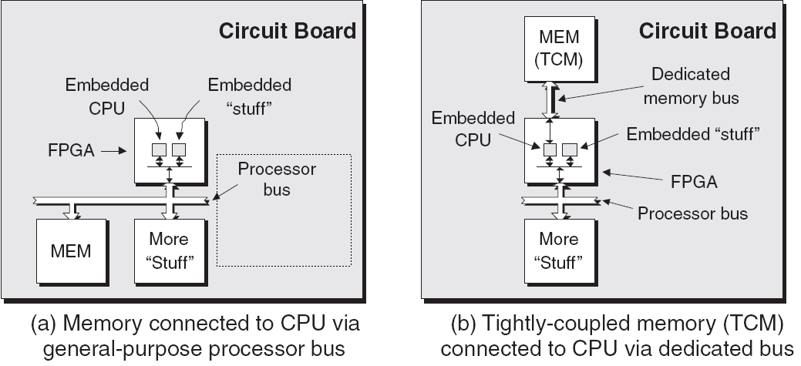
Embedded System Design
In the past, CPU and its peripheral: as discrete chips
→ High area cost,
→ Low reliability.
For relatively small amount of memory, integrated memory in FPGA is used.

Slide 52
SoPC
SoC:
A chip that integrates the major functional elements of a complete end product.
Complex FPGAs:
CPU
Memory
Arithmetic units (multipliers, …)
Peripheral modules
Logic
➔ Whole system on a programmable chip (SoPC)

Slide 53
Challenges
Challenges:
Decision on hardware/software partitioning
Design environment must support hardware/software co-verification.

Slide 54
Microprocessor Cores
Two types:
Hard Core
Implemented as hardwired component
PowerPC, then ARM in Xilinx
ARM in Intel
MIPS in QuickLogic
Soft Core
Configure logic blocks to act as microprocessor(s)
MicroBlaze in Xilinx
NiosII/Nios V in Intel
Q90C1 in QuickLogic

Slide 55
Soft Processor Core
Soft Processor Core:
Disadvantages:
Generally slower
Larger
Advantage:
Can often be customized to exactly suit the needs of the application
→ Gains back some of the lost performance and area efficiency.

Slide 56
Soft Microprocessor Cores
Firm or Soft:
Soft: if in the form of RTL that will be synthesized
Firm: if placed and routed
Peripherals in soft or firm form:
E.g. Memory controllers, interrupt controllers, communication functions, timer counters.
Refer to library of FPGA vendor
Xilinx
MicroBlaze: 32-bit microprocessor (~1000 logic cells)
PicoBlaze: 8-bit microprocessor (~150 logic cells)
Intel:
NIOS V:
32-bits
Based on RICS V

Slide 57
Dedicated Logic on FPGAs

Slide 58
Dedicated Logic on FPGAs
Interconnect protocols

Slide 59
Dedicated Logic on FPGAs
Kintex 7 vs. Spartan 3 both from Xilinx

Slide 60
Recent Dedicated Blocks
AI Engine in “Versal ACAP” device
ACAP: Adaptive Compute Acceleration Platform
Array of VLIW processors with SIMD vector units
Highly optimized for compute-intensive applications:
5G wireless and AI applications

Slide 61
Recent Dedicated Blocks
Heterogeneous Integration of Three Types of Programmable Engines

Slide 62
Recent Dedicated Blocks
Heterogeneous Integration of Three Types of Programmable Engines

Slide 63
Recent Dedicated Blocks
Intelligent Engines

Slide 64
Recent Dedicated Blocks
AI Engine

Slide 65
References
[Xilinx/AMD] www.xilinx.com, www.amd.com
[Altera/Intel] www.altera.com, www.intel.com
م. صاحب‌الزمانی، طراحی کامپیوتری سیستم‌های دیجیتال، نشر شیخ بهایی، 1398

